Slide 1

How foundations for learning are also the foundations for economic and social progress
Martin Gustafsson
February 2025

Slide 2
Three questions addressed regarding the relationship between schooling and country
What does the global and local evidence suggest we should be doing?
What do our policies say we should do?
How well does our schooling system perform?

Slide 3
What does the global and local evidence suggest?
Pre-2000 the world emphasised school enrolments and manpower planning.
Post-2000 vital addition: fundamental language and numeracy skills.
  Prompted largely by researchers such as Hanushek, Kimko, Woessmann.
  2005 UNESCO Education for All report highlighted this evidence.
  The shift from MDGs to SDGs in 2015 was also a shift from just participation, to participation and learning outcomes.
It is not that easy to convey this message, though it should be.

Slide 4
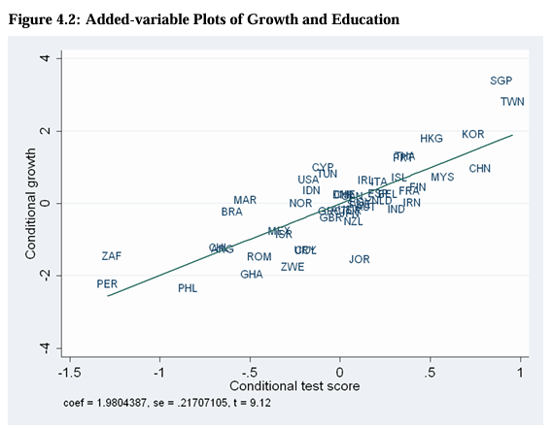
1. What does the global and local evidence suggest? (contd.)
From Hanushek and Woessman (2007). So quite old data.
Of course, correlation is not causality. But additional research confirms the causal link.

Slide 5
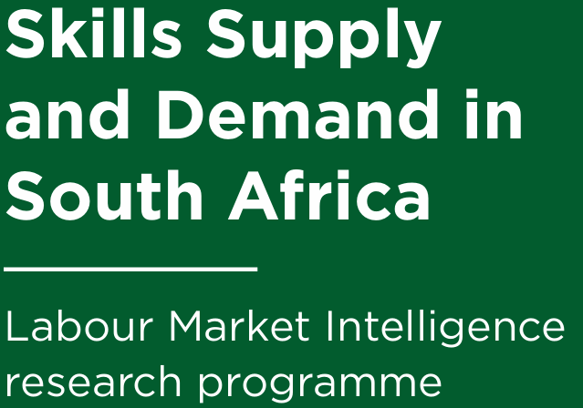
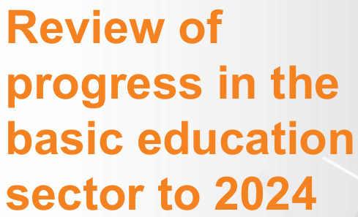

1. What does the global and local evidence suggest? (contd.)
Local evidence can be a bit confusing…
We could do more to bring in these specifics.
Can be distracting | Focus on this…
Inadequate supply of mathematics skills from schools caused in part by declining levels of participation in mathematics. There is a problem of worsening schooling outputs which has contributed to 2021 to 2023 decline in university STEM outputs. (DHET annual report 2023/24.) | This 2022 DHET report finds that youths are twice as likely to obtain university degrees in comparator countries as in to SA. 2024 sector review of DBE finds two-thirds of first-year university students subject to mathematics mark threshold, and that under-supply of around 15% here among school-leavers. 2024 official National List of Occupations in High Demand points to ±350 occupations in high demand – 40% require degree.

Slide 6
2. What do the policies say?
Skills for the 21st century, the various emphases…
UNESCO | World Bank | World Economic Forum
Emphasis on clarifying concepts in four areas: > knowledge > competencies > attitudes > approaches to learning | Three types of skills: > advanced problem-solving > socio-behavioural > adaptability | Digital literacy under the Fourth Industrial Revolution.
2020
On basic education…
“… poor foundation [seen in international assessments] impacts negatively on the types and quality of skills entering the labour market.”
Brookings report confirms SA curriculum is geared towards 21st century.
“The public schooling system does not have an overt focus on creating learner competency in creativity, critical thinking and problem solving.”
“Rather than deploy a suite of technological artefacts to schools, the Commission sees greater potential in insisting on a curriculum that teaches computational thinking.”
“DBE must work towards every school having access to internet and no less than 25 computers and a printer.”

Slide 7
2. What do the policies say? (contd.)
NDP: By 2030 ±85% of youths successfully complete 12 years of education.
NDP: 450 000 youths per year should be ready for mathematically-oriented programmes at university.
MTSF 2014: By 2019, 270 000 Grade 12s per year must obtain at least 50% in mathematics.
MTSF 2019: By 2024, 35 000 Grade 12s per year must obtain at least 60% in mathematics.
We should be moving towards better projections and targets, based on data.

Slide 8
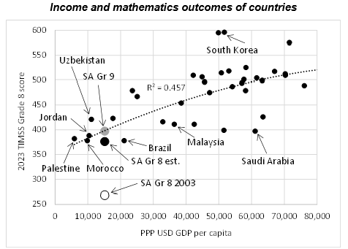
3. How well do we perform?
We appear to be losing our outlier status.
To be included in Action Plan to 2029.

Slide 9
1. High-level mathematics outputs should be ±30% higher to deal with current university demand, and should triple as soon as possible.
3. How well do we perform? (contd.)
1
2. This will reduce the intake of students not meeting mathematics thresholds.
2
3
4
3. University intake should perhaps double in the next 10 years, but this depends on ‘throughput’.
4. Pipeline for those with no NQF 4 should expand, but it won’t be easy.

Slide 10
Sources
Care, E., Kim, H., Anderson, K. & Gustafsson-Wright, E. (2017). Skills for a changing world: National perspectives and the global movement. Washington: The Brookings Institution.
Department of Basic Education (2024). Review of progress in the basic education sector to 2024: Analysis of key statistics. Pretoria.
Department of Communications and Digital Technologies (2020). Diagnostic report of the Presidential Commission on the Fourth Industrial Revolution. Pretoria.
Hanushek, E.A. & Woessmann, L. (2007). The role of school improvement in economic development. Washington: National Bureau of Economic Research.
Hughes, C. & Acedo, C. (2016). Guiding principles for learning in the twenty-first century. Geneva: IBE.
Khuluvhe, N., Bhorat, H., Oosthuizen, M., Asmal, Z. et al (2022). Skills supply and demand in South Africa. Pretoria: Department of Higher Education and Training.
Van der Berg, S., Gustafsson, M. & Malindi, K. (2020). Education and skills for the economy and links to labour markets in South Africa. Pretoria: National Planning Commission.
World Bank (2019). World Development Report 2019: The changing nature of work. Washington.
World Economic Forum (2017). Realising human potential in the Fourth Industrial Revolution: An agenda for leaders to shape the future of education, gender and work. Geneva.

Slide 11


